Slide 1
Attempt to classify the type of crime based on Weather condition
By Bhargav Dalal & Hardik Galiawala

Slide 2
Understanding the data
Historic Weather Condition Data for New York City
The dataset provided basic information about the weather such as humidity, temperature, pressure, wind_direction, wind_speed, etc. along with the date.
Historic Crime data for New York City
The dataset provided the varied type of information but we extracted the required fields from the dataset such as date and the type of crime reported.

Slide 3
Cleaning the data – Weather & Crime
Weather:
Null Values: Replaced it by previous value as the entries in the dataset was hourly
Crime:
Null Values: Dropped the rows
Common:
Dates: Required to explicitly convert the date field to date time data type.

Slide 4
Pre-processing the data
Extraction (Apache Spark):
Weather data:
Extracted the meaningful data for instance, we were interested in the New York city weather data only.
Crime Data:
Extracted the meaningful fields such as date, type of offence, time, etc.

Slide 5
Pre-processing continued..
Transforming and Loading (Apache Spark & MS Azure Data Lake):
Weather Data:
Converted weather_description dataset into numeric from the string based on categories such as light rain, scattered rain, snowy, etc.
Combine the different dataset such as humidity, temperature, weather_description, etc. into one file.
This file was loaded in Azure Data Lake and calculated statistical characteristic for each column which was group by on the date field.

Slide 6
Pre-processing continued..
Transforming and Loading (Apache Spark & MS Azure Data Lake):
Crime Data:
Stringindexer was used to convert crime type into integer categorical variable.
Common:
The file obtained from Azure data lake and crime data were then combined in one file using Apache Spark.

Slide 7
Visualizations:
Jupyter Notebook:
Feature Importance calculations.
PowerBI:
Analytical visualizations.

Slide 8
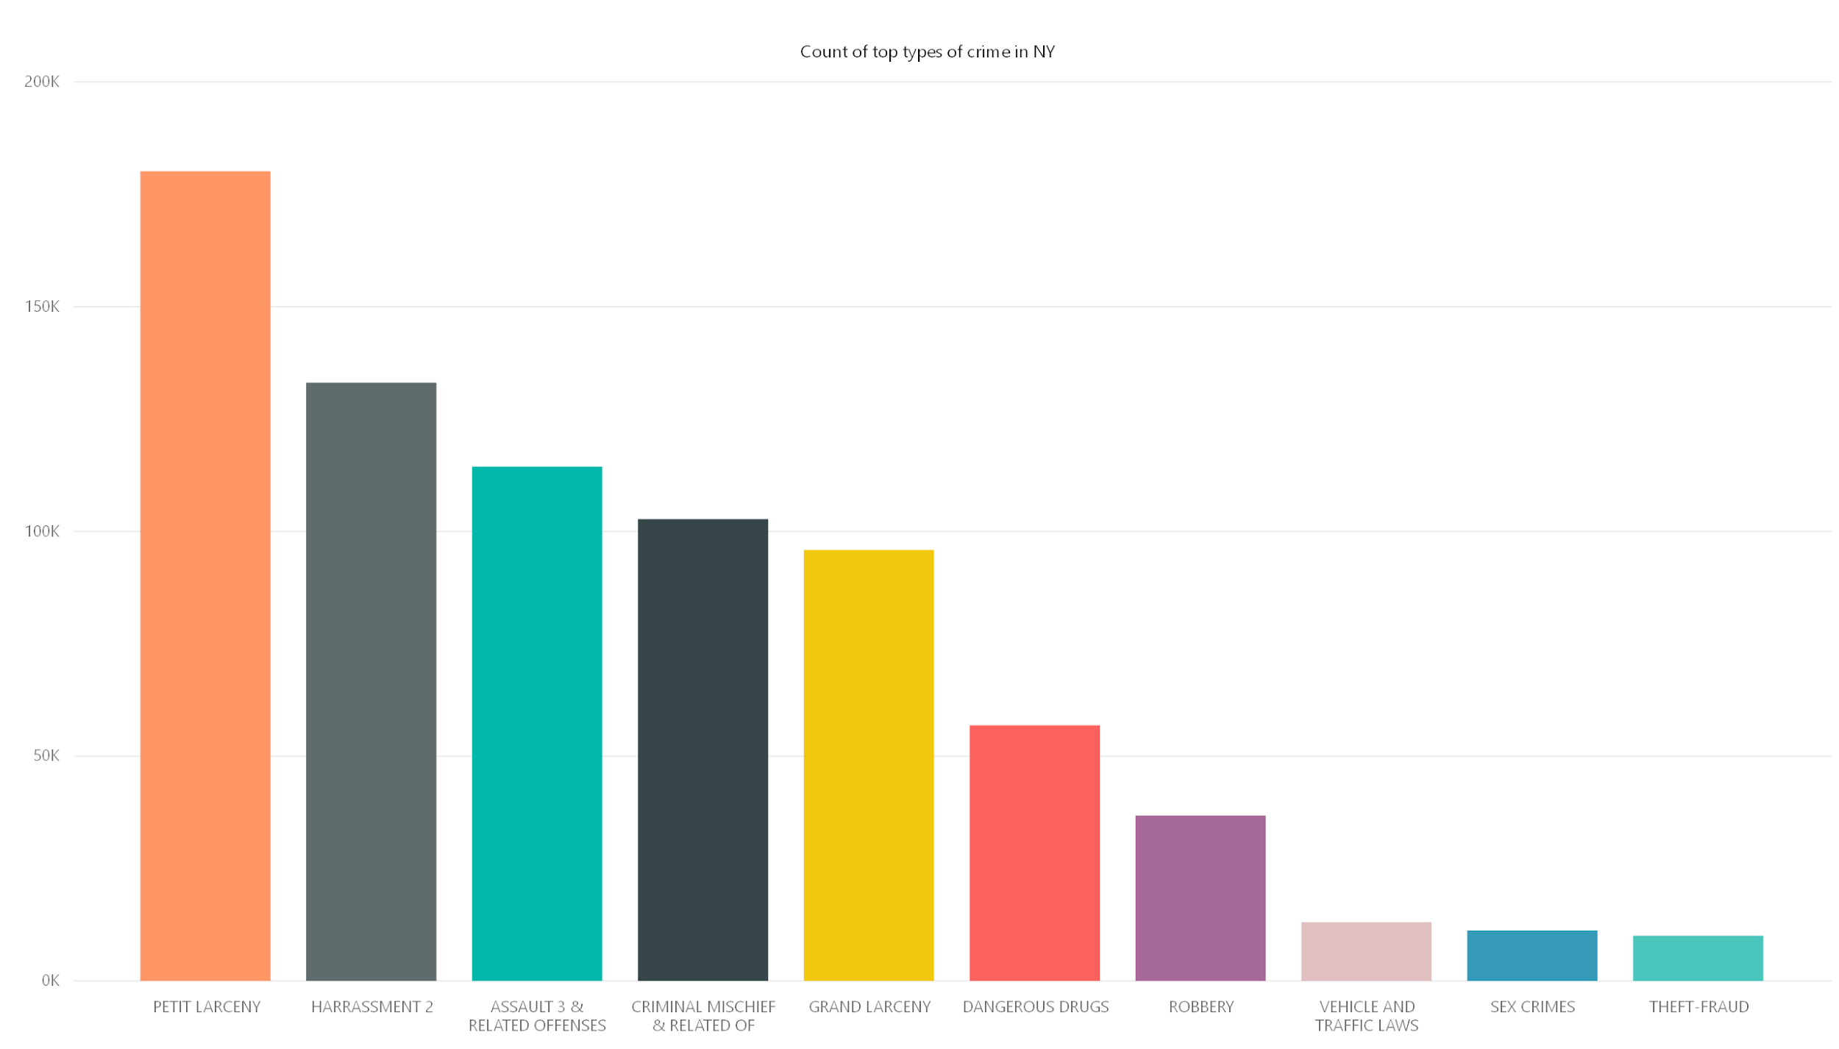

Slide 9
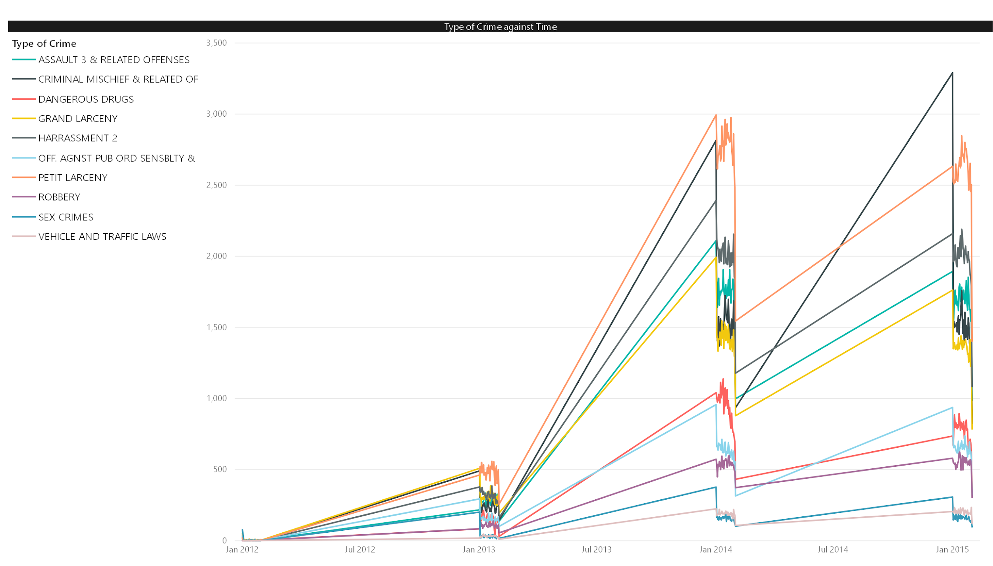

Slide 10
Feature Importance
Feature | Feature importance (Gini-index )
Temperature | 0.3245
Pressure | 0.2092
Wind_direction | 0.1952
Wind_speed | 0.1448
Humidity | 0.1197
Weather_description | 0.0066

Slide 11
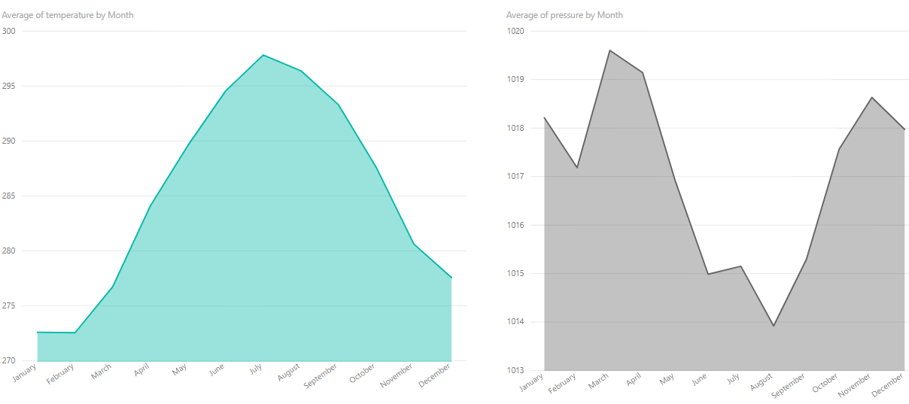

Slide 12
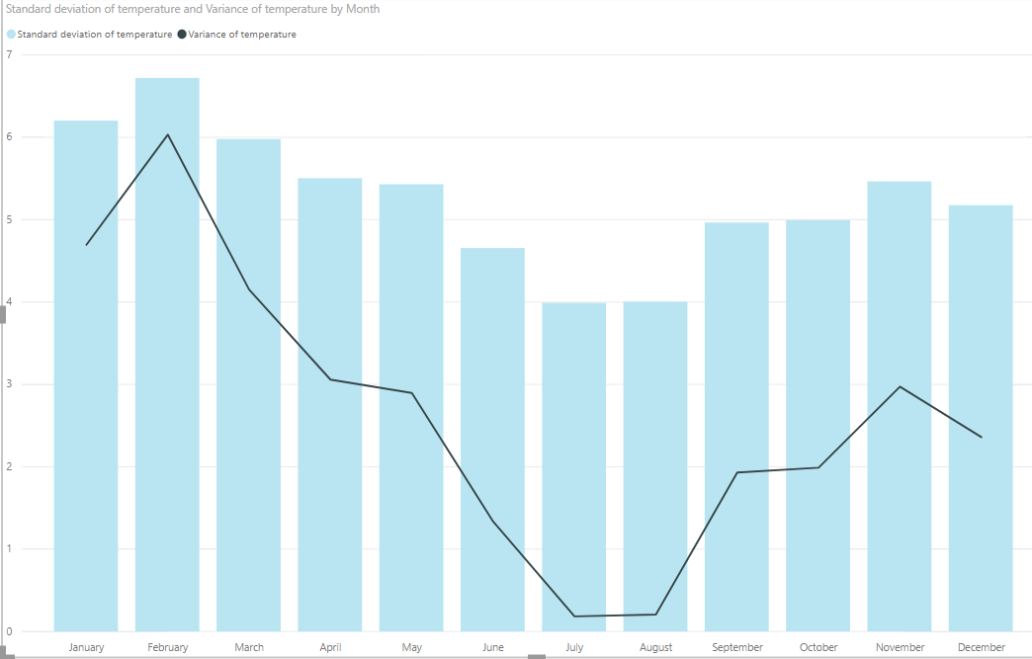

Slide 13
Sprints
Data cleaning and preprocessing
Data Transformation
Data Visualization

Slide 14
Value Proposition
Crime branch
Government offices

Slide 15
Conclusion
We tried to identify the type of crime based on the weather condition.
There may be other factors to consider.
Biased Dataset.
Weather conditions may not solely classify the crime type.

Slide 16
Any Questions?

